Slide 1
COMMUNICATING INSIGHTS AND
ANALYSIS

Slide 2
INTRODUCTION
As we delve into the intricacies of our data, we'll focus not only on presenting visually compelling information but also on delivering actionable insights.
To ensure the accuracy and reliability of our findings, I've taken great care in the initial phase to clean the data thoroughly, eliminating any potential distortions.
I'll be presenting insights derived from a meticulous analysis of trends and breakdowns across various categories.

Slide 3
PROCESS
I cleaned up the data which is provided by removing all the negative values in the unit price and quantity columns and also filtered the data as required for all the visualizations.
I assure that I took all the necessary steps to ensure that this analysis is accurate and correct.
Notes:
Photo by Campaign Creators on Unsplash

Slide 4
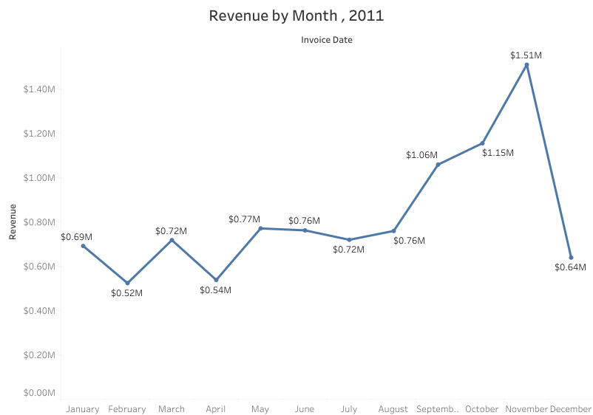
The first 8 months have stable monthly revenues with the average of $685,000
We had a significant increase in revenue from september with the revenue peaking at $1.51M in November and an average of 21.18% increase in revenue from August to November
The revenue trend from August to December demonstrates how seasonality affects retail store sales
REVENUE BY MONTH,2011

Slide 5
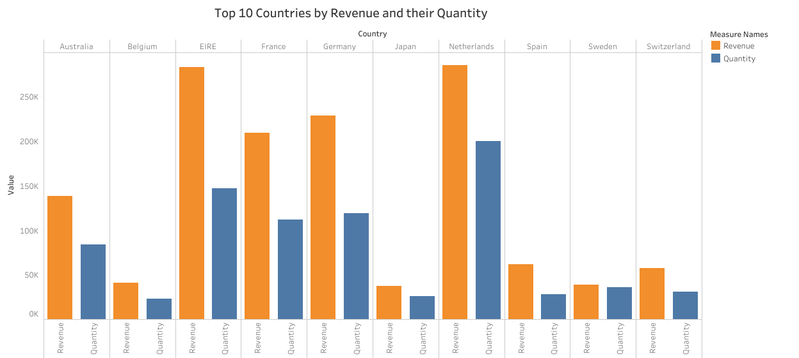
The chart represents Top 10 countries in revenue and the quantities bought in these countries except The United Kingdom.
There is no major difference between the revenue and the quantity of goods sold in these countries, showing a high purchasing power in these countries.
These countries represent regions with the highest potential to generate more revenue that management needs to focus more on in terms of marketing strategies.
TOP 10 COUNTRIES BY REVENUE AND THEIR QUANTITY

Slide 6
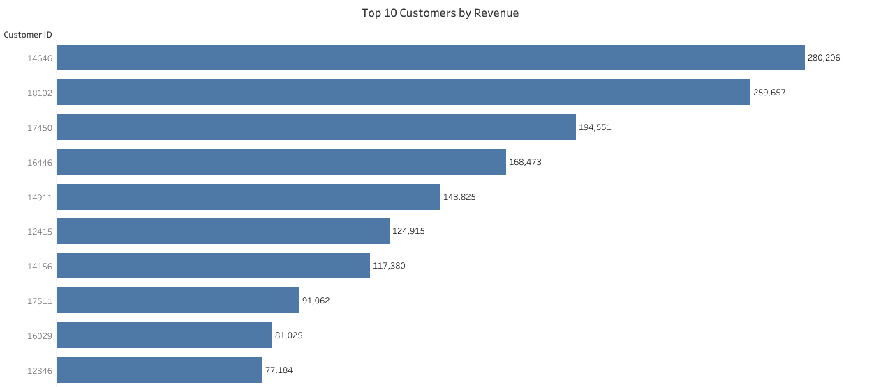
The chart shows that there is no major difference between the top 10 customers in terms of revenue generated
The average difference in revenue between the top 10 customers is 15.8%
The company can aim to strengthen the relationship with these customers to increase customer loyalty and retention and ultimately drive more sales and revenue for the company
TOP 10 CUSTOMERS BY REVENUE

Slide 7
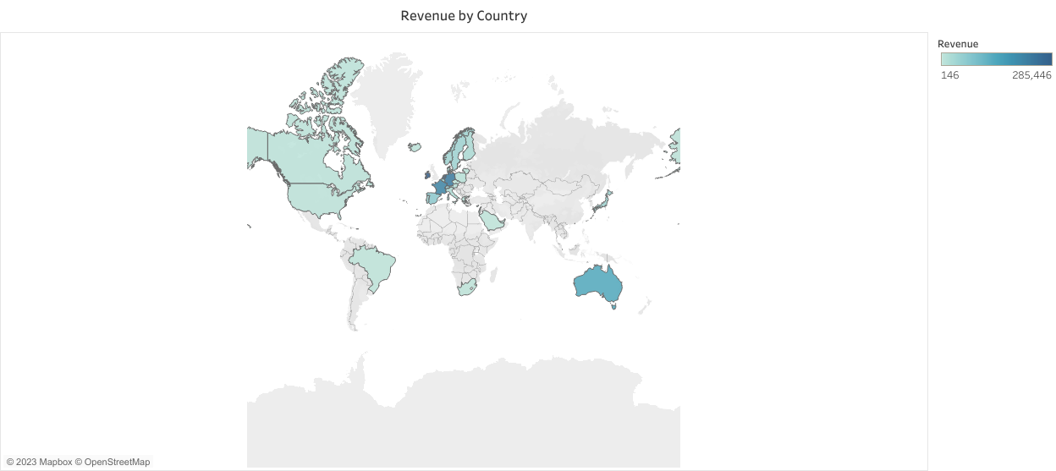
The map chart concludes by comparing the places that have produced the greatest revenue to those that have not
The map also reveals that the majority of sales occur only in the European zone, with only a small number in the American region
Along with Russia there is no market for the items in Africa or Asia
The company can concentrate on the European market more and dive deeper into countries in the region to come up with strategies that will maximize sales from each country in the region alongside Australia and Japan
REVENUE BY COUNTRY

Slide 8

QUESTIONS?

